Slide 1
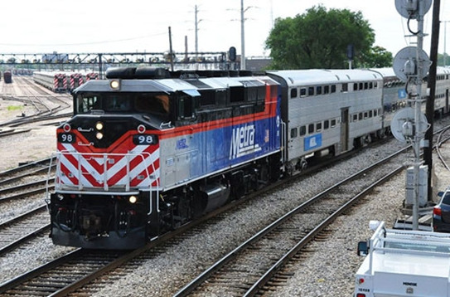
“Disadvantaged Business Enterprise (DBE) Certification 101”
Presented by:
Adriana Mena, DBE Certification Specialist

Slide 2
DBE Overview
What is a DBE?
Ownership
An independent business that is at least 51 percent owned by a socially or economically disadvantaged individual(s)
Socially disadvantaged individual(s) include:
Women, Native Americans, African Americans, Hispanic Americans, Asian-Pacific Americans and Subcontinent Asian Americans
Personal Net Worth (PNW)
Majority owner’s personal net worth must not exceed $1.32 million
Control
The majority owner must control the management and daily operations
Size
A for-profit business must meet the Small Business Administration’s (SBA) size standard and not exceed $28.48 million in gross annual receipts over a five-year average

Slide 3
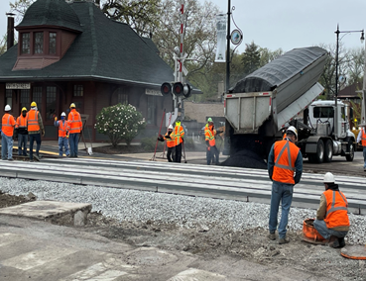
DBE Overview
Different agencies recognize different certifications
DBE Certification:
United States Department of Transportation (US DOT) assisted contracts for highway, transit, and airport projects
Complies with Federal Regulation 49 CFR Part 26
M/WBE Certification:
Overseen and managed by state and local government contracting authorities

Slide 4
DBE Overview
Firms with DBE Certification through one of these agencies are recognized by all the others
The Illinois Unified Certification Program (IL UCP) directory provides a reference source of certified DBE firms. The Directory lists firms in alphabetical order, including the NAICS* codes and specialties. It provides a reference source to assist bidders/proposers in meeting DBE contract goals.
*North American Industry Classification System (NAICS) Codes – classification of the specialties or services that a firm seeks to perform.

Slide 5
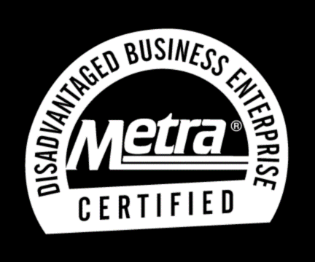
DBE Overview
Advantages of DBE Certification
Company listed in the IL UCP DBE vendor directory
An opportunity to participate on federally funded or assisted projects as prime contractors or subcontractors
An identifier that can be used as a marketing tool for your business

Slide 6
DBE Certification Process
Determining Eligibility
The certification application, Personal Net Worth (PNW) statement and supporting documents are analyzed.
A site visit is conducted to verity the firm’s business, which includes a tour of the facility and photographs.
A final determination is made on whether the firm is eligible for DBE certification and the firm is notified via email.
The DBE Program complies with the US DOT 49 CFR, Part 26, Subpart D, which provides the certification guidelines and procedures.
Process takes 60 to 90 days upon the receipt of all required documentation.
*Due to COVID 19, some processes have been temporally modified.

Slide 7
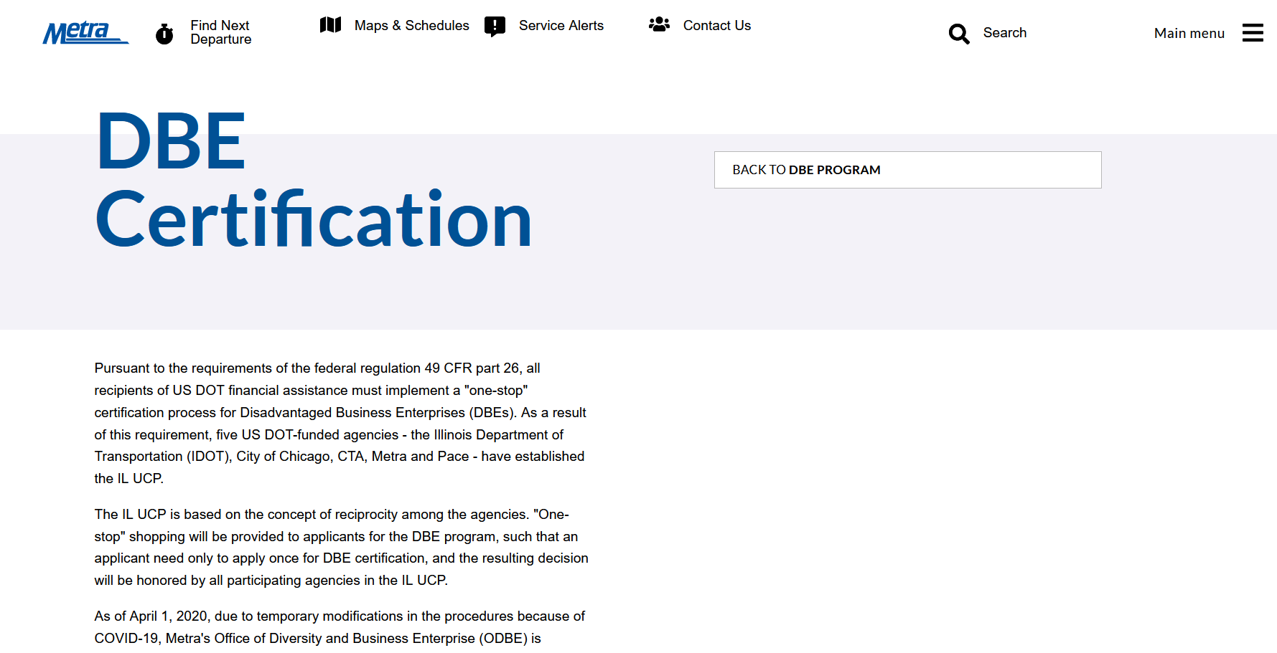
DBE Certification Application
METRA.COM
MAIN MENU
BUSINESS OPPORTUNITIES AND RESOURCES
OFFICE OF DIVERSITY & BUSINESS ENTERPRISE
DBE PROGRAM
DBE CERTIFICATION

Slide 8
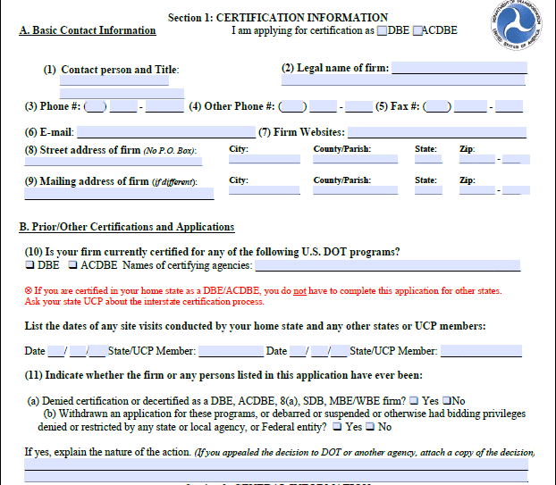
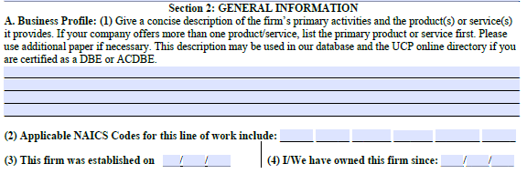
DBE Certification Application
Leave no blanks – If it does not apply to you or your firm, mark the section N/A
Ensure that the contact person is the Majority Owner of the Firm
List of NAICS Codes can be found at https://www.census.gov/naics/

Slide 9
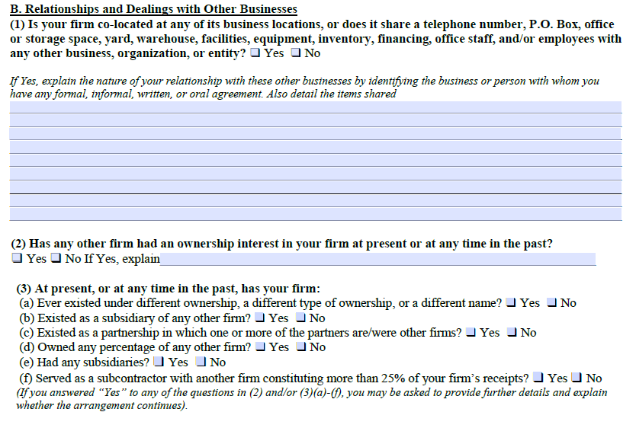
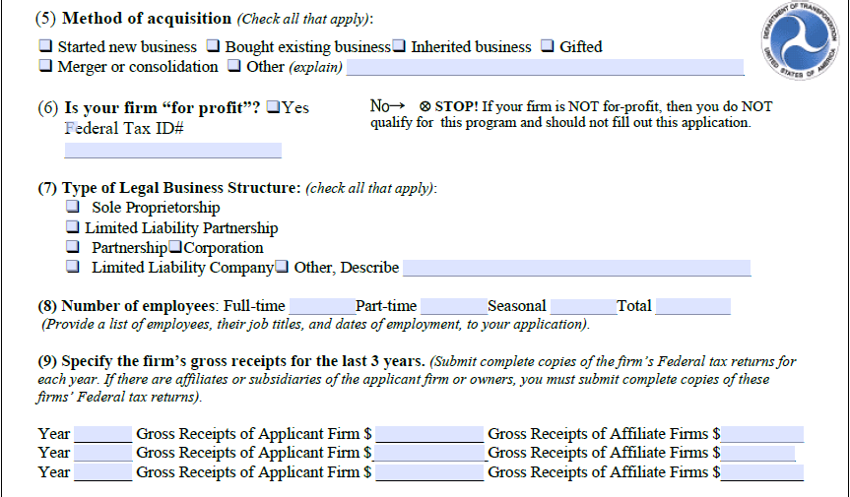
DBE Certification Application
As owner of the firm, you are also considered an employee of the firm
Include the gross receipts of any affiliate firm, if there is none, mark N/A
Include any supporting documentation for any co-sharing of business resources

Slide 10
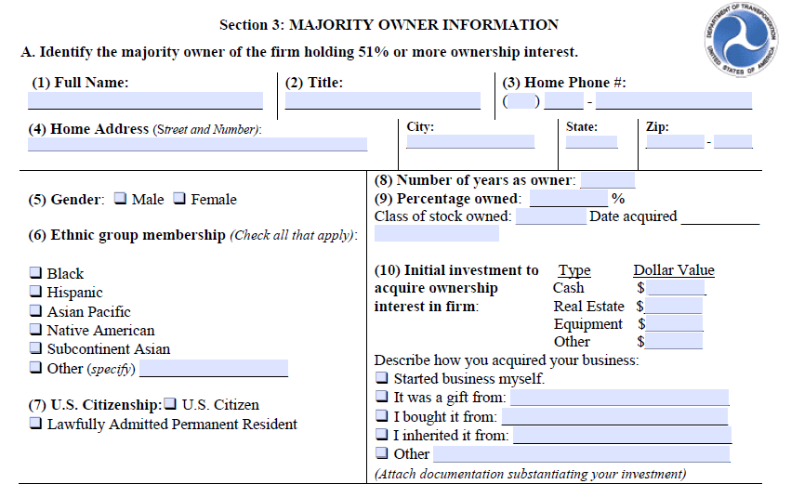
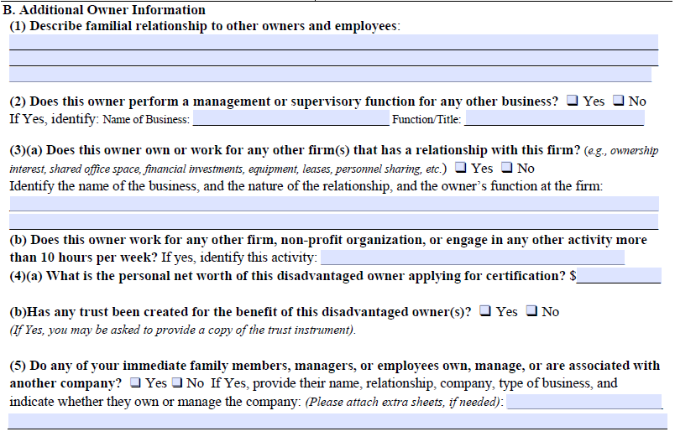
DBE Certification Application
Ensure that the initial investment matches your supporting documentation
Include a stated explaining any managerial work or ownership done for another firm
Include a copy of the trust agreement

Slide 11
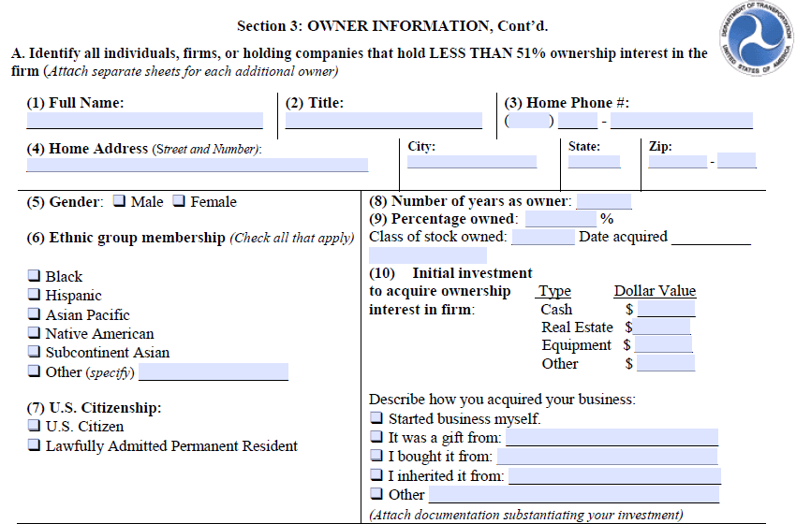
DBE Certification Application
If no other owners, mark this section N/A
Ensure to list the other owner’s ethnic group
If the firm is owned 50/50, each owner needs to fill out an owner information form and Personal Net Worth Statement

Slide 12
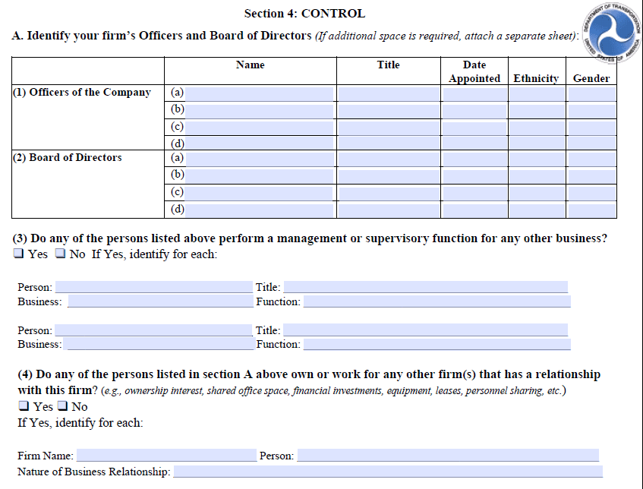
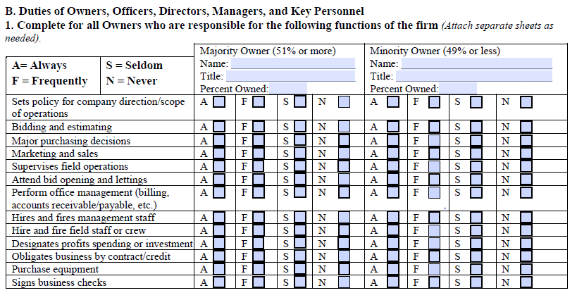
DBE Certification Application
If your firm is a corporation, ensure that the Board of Director here, match the number of directors required listed in the firm’s Bylaws
If the firm is does not have another owner, list n/a in the minority owner section

Slide 13
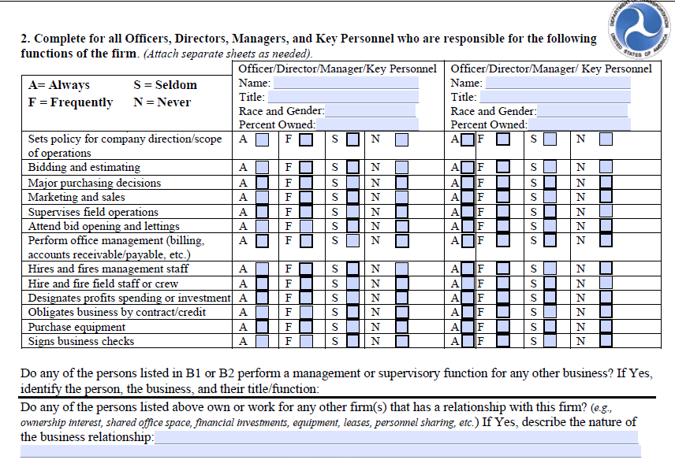
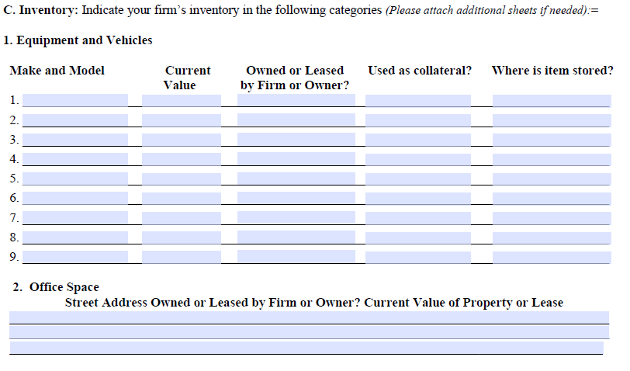
DBE Certification Application
This section should be filled out for any managers or key personnel of the firm
If the firm only has office equipment, mark n/a here
If the firm is located at the owner home, list the information for the home

Slide 14
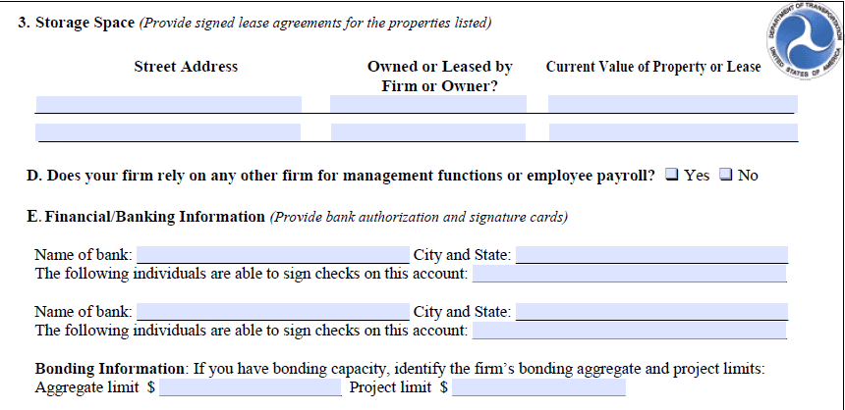
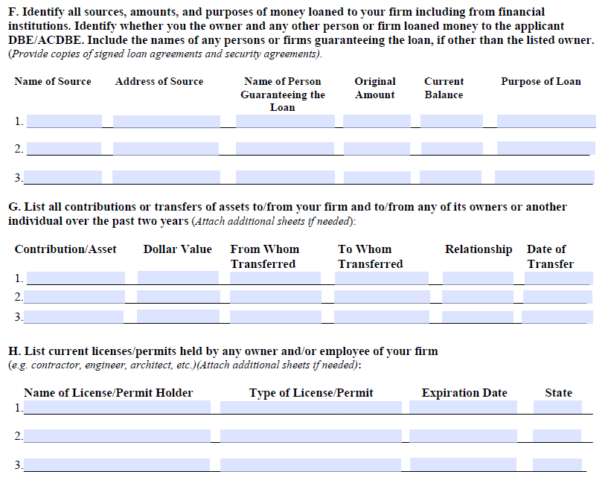
DBE Certification Application
If applicable, provide a copy of any bonding letter
If applicable, provide copies of any loan agreements for outstanding loans
Ensure that the firm has all the licenses or permits required by the State or City or Village that the firm is in

Slide 15
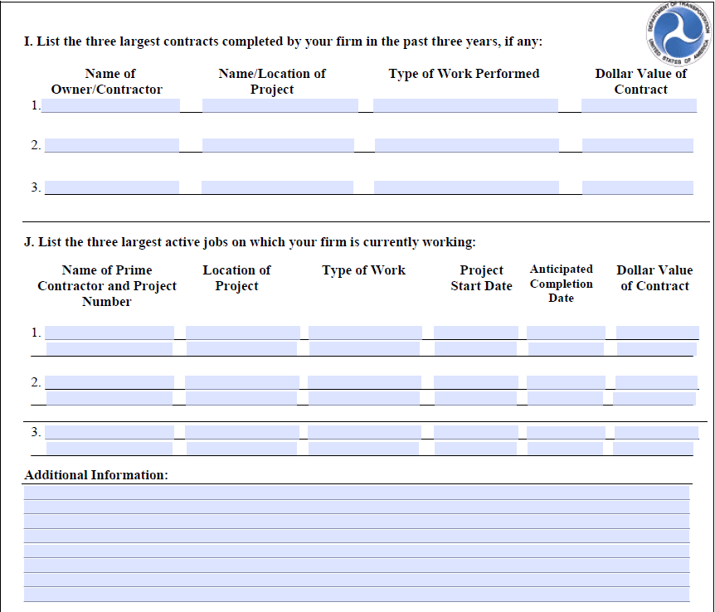
DBE Certification Application
Provide a copy of the three largest active contracts the firm is currently working on
If the firm is not currently working on a project, provide a signed statement explaining the reason

Slide 16
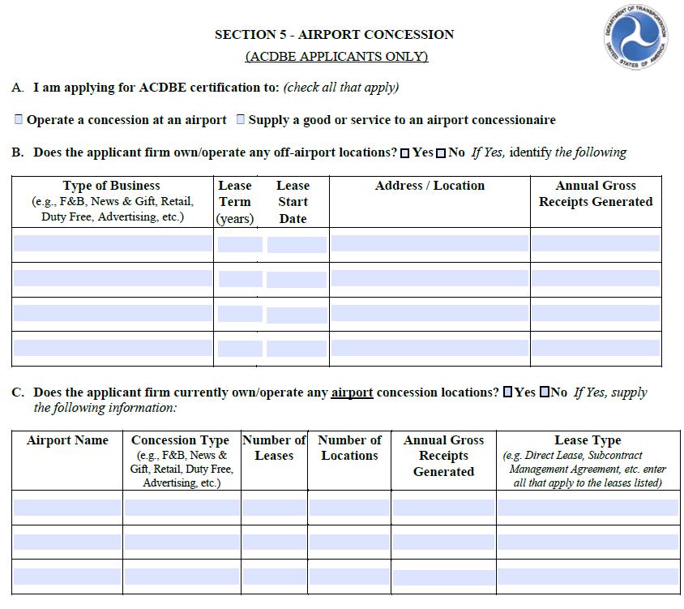
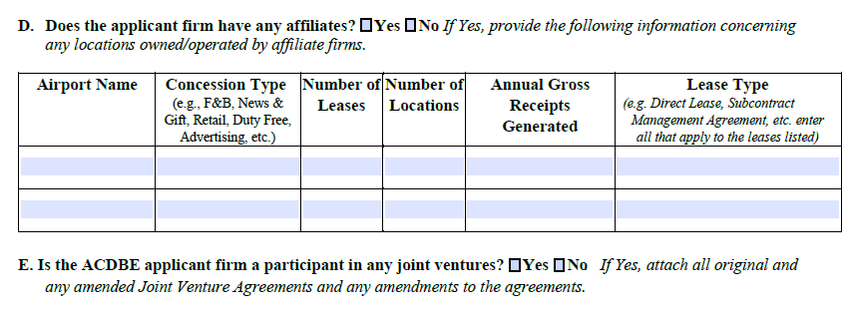
DBE Certification Application
If your firm is wishing to received ACDBE certification, you will have to apply to the City Of Chicago
If your firm is not wishing to apply for ACDBE certification, mark n/a on this page

Slide 17
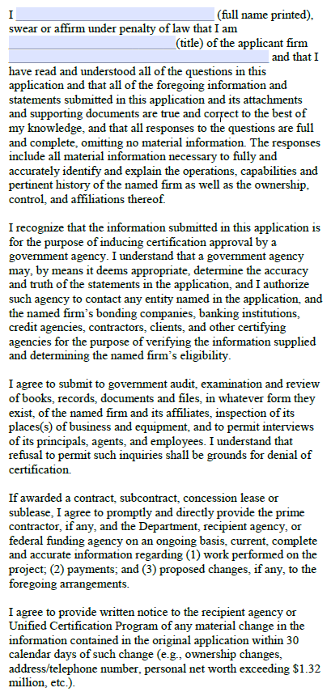
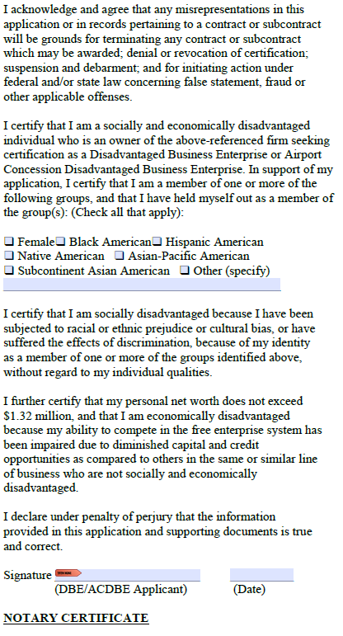
DBE Certification Application
Make sure this page is signed and notarized
If the firm is owned 50/50, each owner needs to fill out, sign, and notarize a page

Slide 18
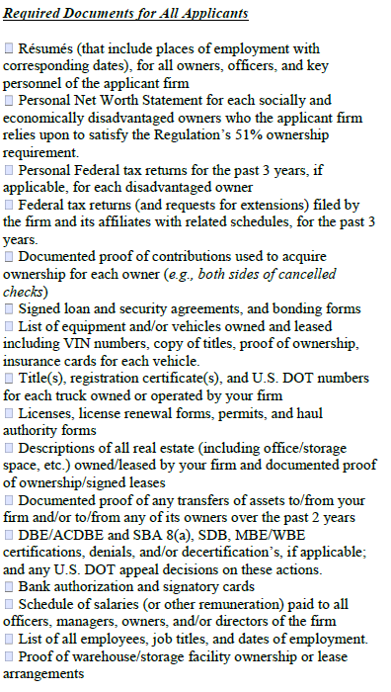
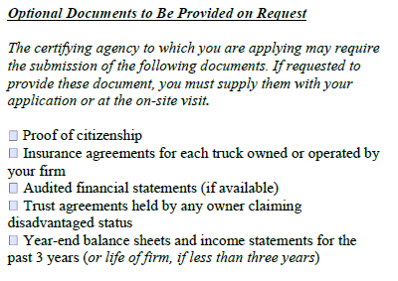
DBE Certification Application
If any of the items requested do not apply to your organization, provide a signed statement listing the items not applicable
An optional document that will be requested is the year-end balance sheet and income statements for the past 3 years

Slide 19
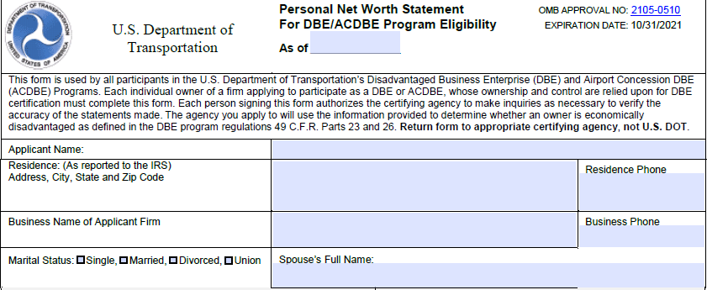
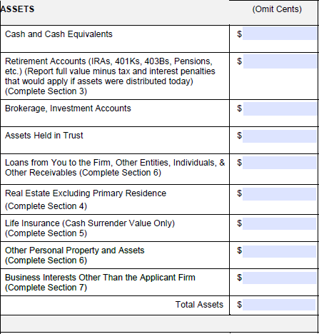
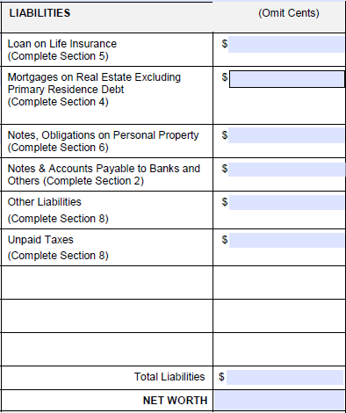
Personal Net Worth Statement
Complete this form to only include what is personally owned by individual applying for DBE certification
If the assets or liability is co-owned, please make a note and on this page only include your portion
If an item required additional information, complete each section as listed by the item
The real estate portion should not include any amounts related to the owner’s primary residence
Ensure that the Net Worth is calculated (Total Assets – Total Liabilities = Net Worth)

Slide 20
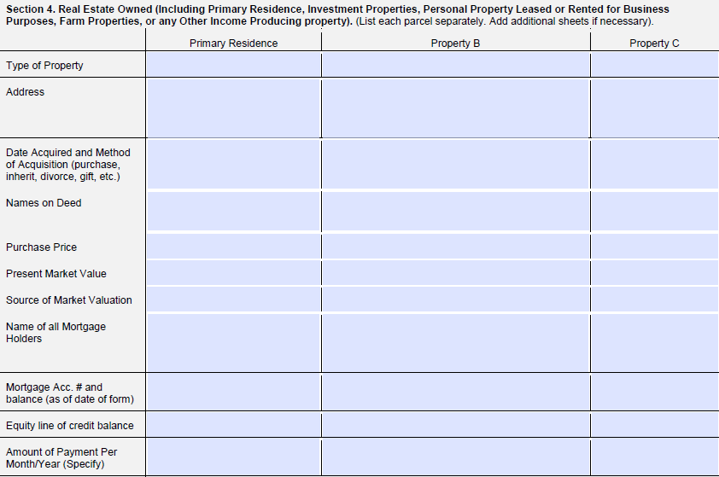
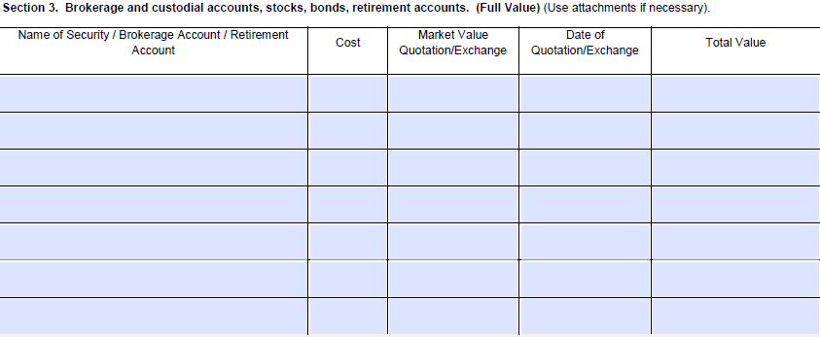
Personal Net Worth Statement
Complete each corresponding section with the information that matches page 1 of the Personal Net Worth Statement
The primary residence should be listed on section 4, but the amount is not included on page 1)

Slide 21
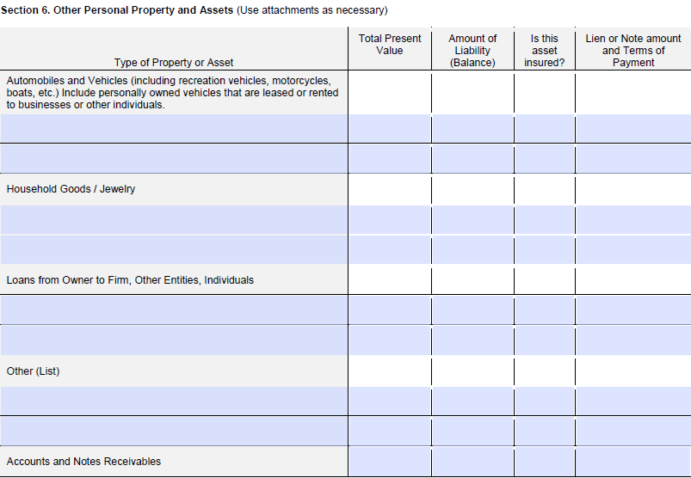
Personal Net Worth Statement
Make sure this page is signed and notarized
If the firm is owned 50/50, each owner needs to fill out, sign, and notarize their own Personal Net Worth Statement
List any affiliate business(es) owned on section 7

Slide 22
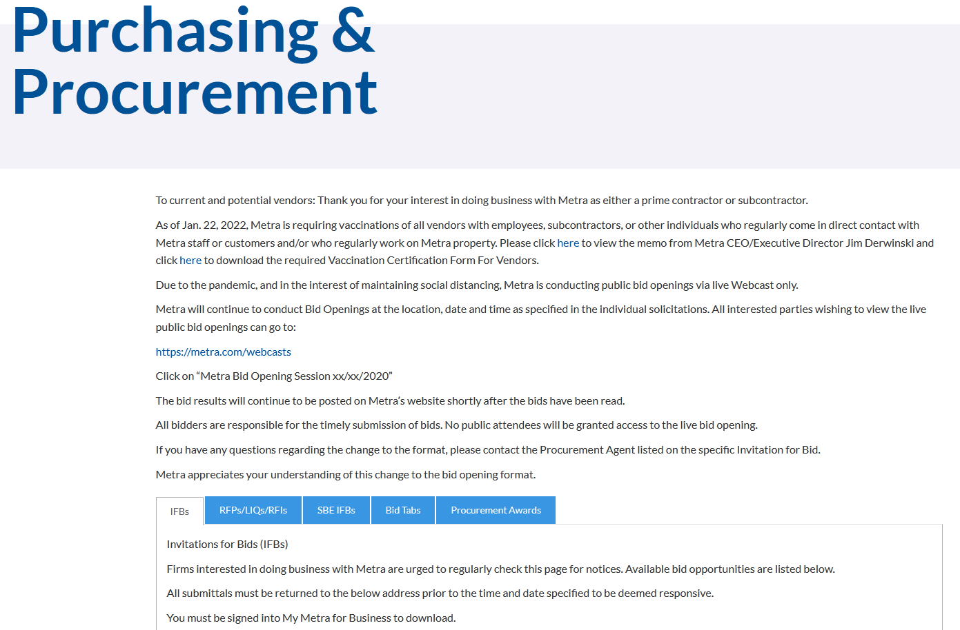
Contract Opportunities
METRA.COM
MAIN MENU
PURCHASING & PROCUREMENT
BUSINESS OPPORTUNITIES AND RESOURCES
Annual Procurement Plan
The Procurement Plan, updated quarterly, identifies potential contracting opportunities for goods and services anticipated by Metra Departments such as Engineering, Mechanical, Fleet and Facility Management, Finance, Information Systems and Materials and Stores. This document also includes information about vendor registrations and how Metra ensures that small, minority and women-owned businesses have equal opportunity to receive and participate in Metra contracts. Review Metra’s Annual Procurement Plan here.

Slide 23
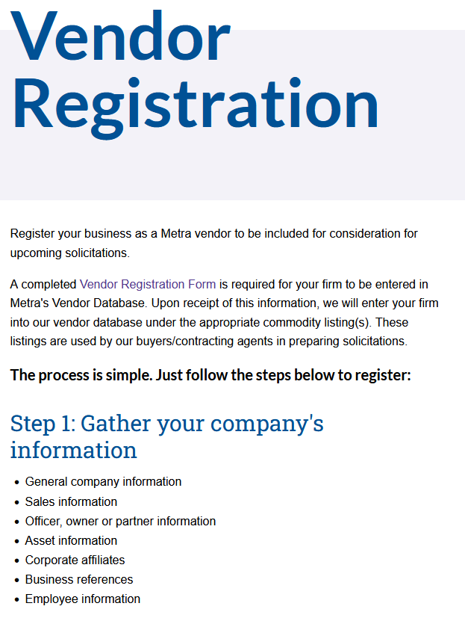
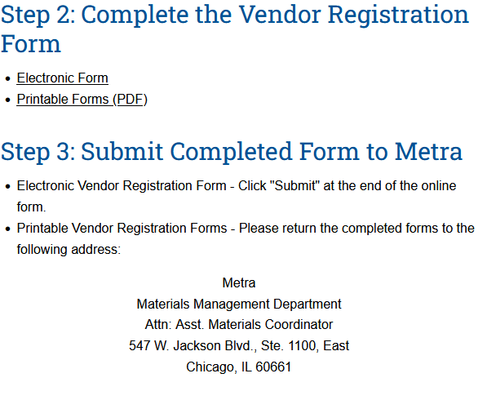
How To Register As A Vendor
MAIN MENU
PURCHASING & PROCUREMENT
BUSINESS OPPORTUNITIES AND RESOURCES
METRA.COM
Note: Please include the correct NAICS codes relating to the business or services provided to ensure you will receive solicitations from the Procurement Department.

Slide 24
QUESTIONS
Contact Information
Adriana Mena (amena@metrarr.com)
Michele Sutton (msutton@metrarr.com)

